Slide 1
THE JET AIRPLANE
Invented by Henri Coanda
Project by Ungureanu Teo

Slide 2
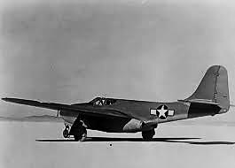
A jet aircraft (or simply jet) is an aircraft propelled by jet engines.

Slide 3
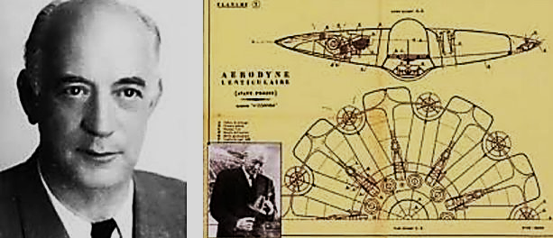
Henrie Marie Coandă was a Romanian inventor, and builder of an experimental aircraft.

Slide 4
The Coandă – 1910
The Coandă – 1910 was an aircraft powered by a ducted fan.
Called the "turbo-propulseur" by Coandă.
The unusual aircraft attracted attention at the Second International Aeronautical Exhibition in Paris in October 1910.

Slide 5
Decades later, after the practical demonstration of motorjets and turbojets, Coandă began to tell various conflicting stories about how his early experiments were precursors to the jet, even that his turbo-propulseur was the first motorjet engine with fuel combustion in the airstream.
He also claimed to have made a single brief flight in December 1910, crashing just after takeoff, the aircraft being destroyed by fire.

Slide 6
General characteristics
Crew: 1
Length: 12.5 m (41 ft 0 in)
Wingspan: 10.3 m (33 ft 10 in)
Wing area: 32 m² (350 ft²)
Weight: 420 kg (920 lb)

Slide 7
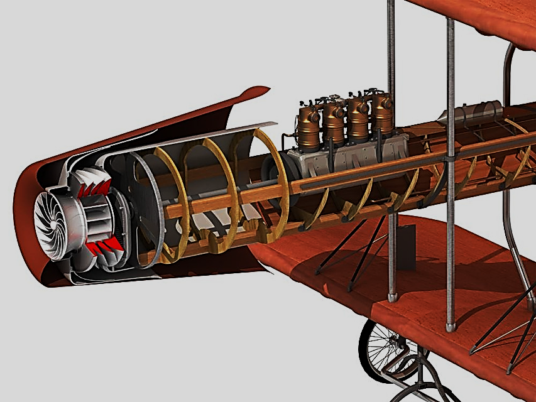
The Coandă – 1910

Slide 8
Born in Bucharest, Coanda was the second child of a large family.
His father was General Constantin Coanda, a mathematics professor at the National School of Bridges and Roads.
His mother, Aida Danet, was the daughter of French physician Gustave Danet, and was born in Brittany.
He was later to recall that even as a child he was fascinated by the miracle of wind.

Slide 9
Coandă studied at the Petrache Poenaru Communal School in Bucharest, then (1896) at the Liceu Sf. Sava (Saint Sava National College).
After three years (1899), his father, who desired a military career for him, had him transfer to the Military Highschool in Iași.
He graduated from that institution in 1903 with the rank of sergeant major, and he continued his studies at the School of Artillery, Military, and Naval Engineering in Bucharest.
Sent with an artillery regiment to Germany (1904), he enrolled in the Technische Hochschule in Charlottenburg, Berlin.

Slide 10
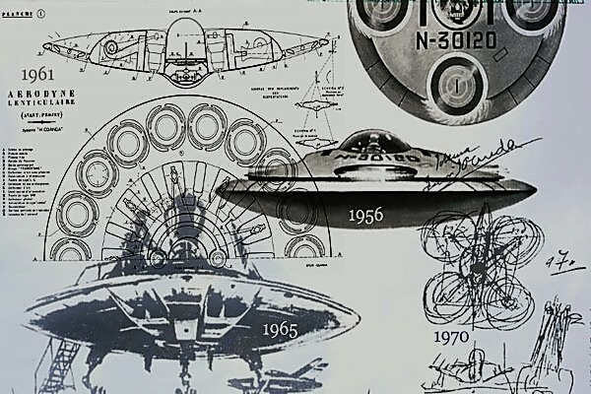
Aerodyne of Coandă a kind of flying saucer

Slide 11
With the support of engineer Gustave Eiffel and the mathematician, politician, and aeronautical pioneer Paul Painlevé, he began experimenting the aerodynamic techniques: one of this experiments was mounting a device on a train running at 90 km/h so he could analyze the aerodynamic behavior.
Another experiment used a wind tunnel with smoke and an aerodynamically balance to profile wings to be used in designing aircraft.
This later led to the discovery of the aerodynamic effect now known as the Coandă effect.

Slide 12
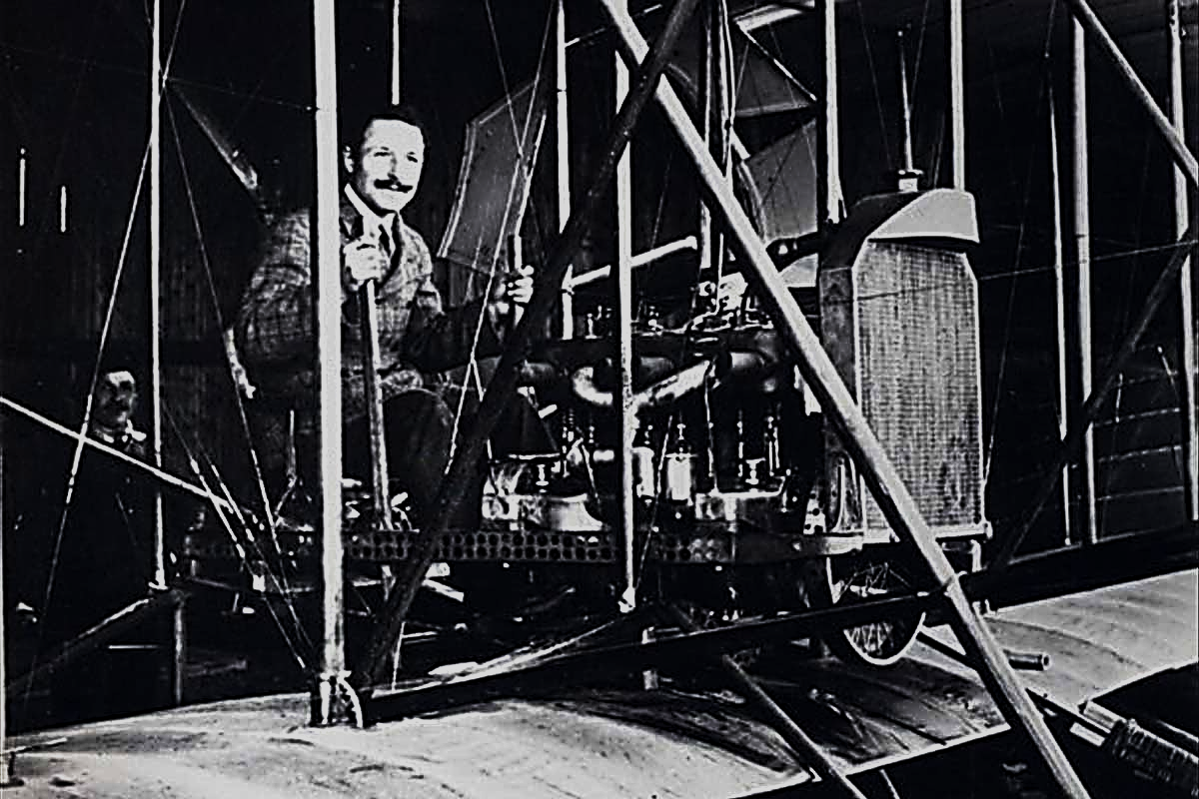
Gianni Caproni

Slide 13
In 1910, using the workshop of Gianni Caproni, he designed, built and piloted the first ”thermojet” powered aircraft, known as the Coandã-1910, which he demonstrated publicly at the second International Aeronautic Salon in Paris.
The powerplant used a 4-cylinder piston engine to power a compressor, which fed to two burners for thrust, instead of using a propeller.
It would be nearly 30 years until the next thermojet powered aircraft, the Campini Caproni CC.2.

Slide 14
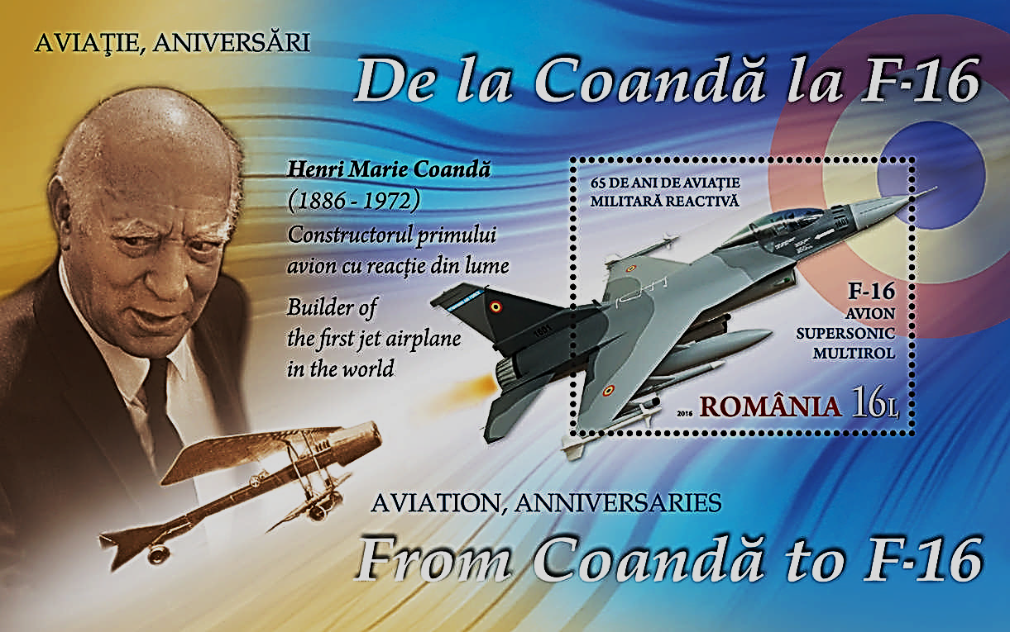
Coandă died in Bucharest
November 25, 1972 at the age of 86.

