Slide 1
LIGHT SERIES AND PARALLEL CIRCUITS
Created by pupils from
Elementary School ”Theodor Costescu”

Slide 2
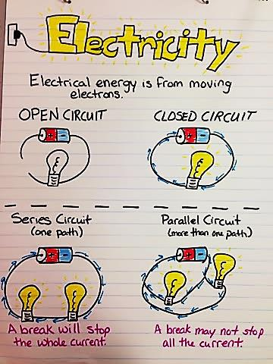
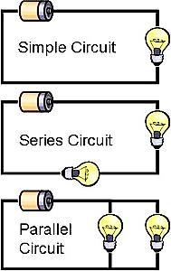
ELECTRICITY in some pictures

Slide 3
EXPERIMENTS FOCUS
We discuss simple circuits and the differences between parallel and serial circuit design and functions.
We work in teams to predict the difference between the two circuit designs, and then build examples of the two different circuits using conductor wires, resistors, multimeter and batteries.

Slide 4
WHAT IS A SIMPLE CIRCUIT?
A simple circuit consists of three elements:
a source of electricity (battery);
a path or conductor on which electricity flows (wire);
a electrical resistor, which is any device that requires electricity to operate.

Slide 5
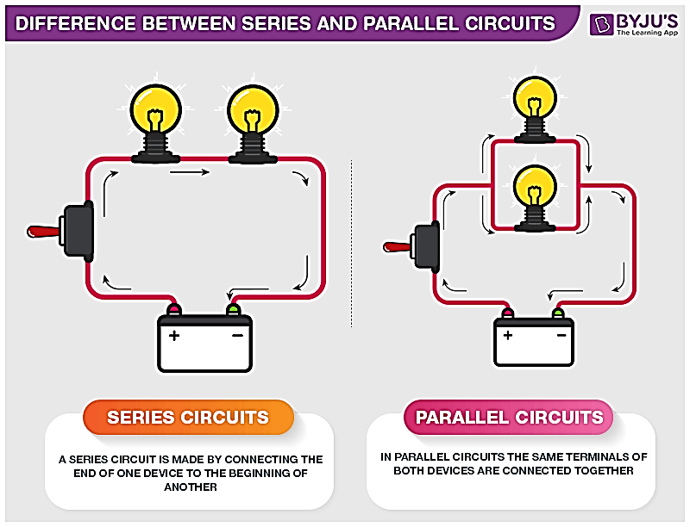
What are Series and Parallel Circuits?
Series and parallel describes two different types of circuit arrangements.
Each arrangement provides a different way for electricity to slow throughout a circuit.

Slide 6
SERIES CIRCUITS
In a series circuit, electricity has only one path on which to travel.
Electricity flows from the battery to each bulbs, one at a time, in the order they are wired to the circuit.
In this case, because the electricity can only flow in one path, if one of the bulbs blew out, the other would not be able to function because the flow of the electric current would have been interrupted.

Slide 7
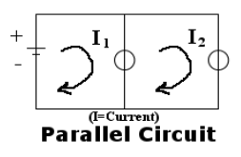
PARALLEL CIRCUITS
In a parallel circuit, electricity has more than one path on which to travel.
In the example on right, two bulbs are powered by a battery in a parallel circuit design.
In this case, because the electricity can flow in more than one path, if one of the bulbs blew out, the other bulb would still be able to light up because the flow of electricity to the broken bulb or would not stop the flow of electricity to the good bulb.

Slide 8
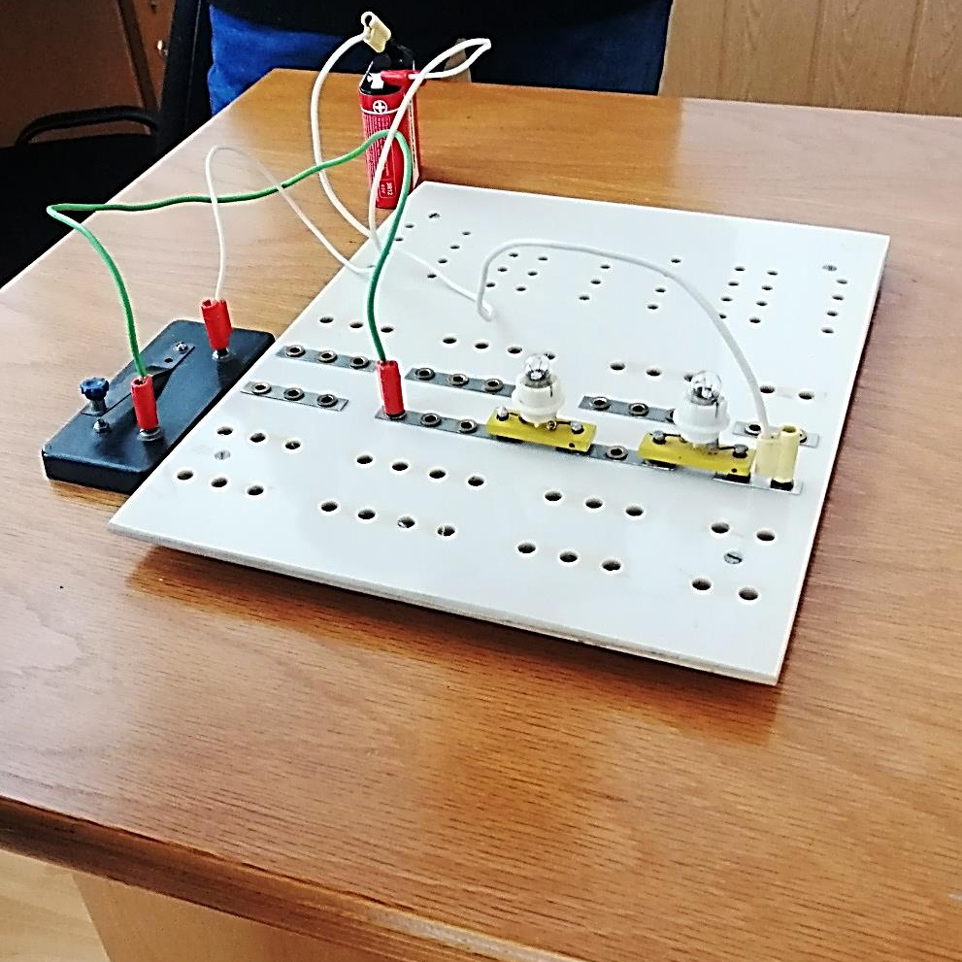
AN EXAMPLE OF SERIES CIRCUITS
Poza circuitului
realizat de noi

Slide 9
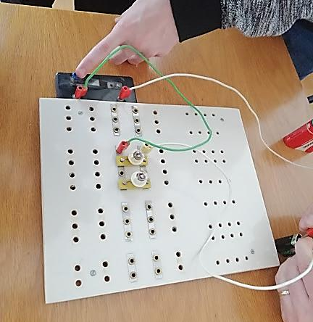

AN EXAMPLE OF PARALLEL CIRCUITS

Slide 10
STEM ACTIVITY!
You are the experimenter! You need to design a system where one switch can turn on multiple lights!
An example might be a string of holiday lights.
Now, construct both a series circuit and a parallel circuit using aluminum foil as wires, holiday lights, switch, tape, cartoon and a 9-Volt battery.
Below is an example of a series and parallel circuit.

Slide 11
Holiday Light Series and Parallel Circuits

Slide 12
THANK YOU
FOR YOUR ATTENTION!

