Slide 1
Made by Vasile Lorena
The Ejectable Seat

Slide 2
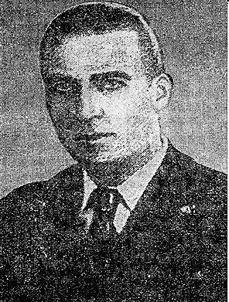
Who is Anastase Dragomir?
Anastase Dragomir(1896-1966) was a distinguished Romanian inventor, born in Brăila, who worked in France at several aircraft factories, where he perfected a system to save pilots and passengers in case of accidents.
During his childhood, Anastase witnessed the test rumors of Vuia and Vlaicu, but was also marked by the death of the second during a flight made in 1913 with the purpose of crossing the Carpathians.

Slide 3
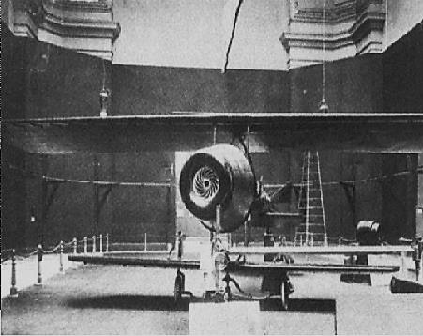
The Catapulting Cabin
During several years of studies and experiments at his workplaces, Anastase Dragomir manages to develop a first real security system, and in his efforts was helped by another Romanian, Tanase Dobrescu.
Thus, on November 3, 1928 , he filed a patent application in France with the name ‘’Nouveau systѐme de montage des parachutes dans les appareils de locomotion aѐrienn’’, which in English translates to ‘’New system for mounting parachutes on apparatus air movement’’.

Slide 4
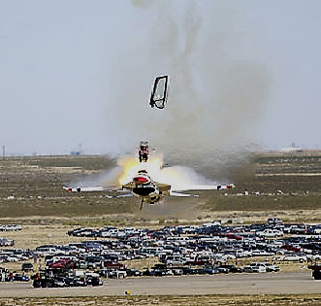
Dragomir managed to test the invention for the first time on August 29,1929,due to the numerous financial difficulties that the aviation industry was experiencing.
The experiment took place near Orly Airport near Paris.
An aircraft of the French company Farman was used in the test where a catapulting cab was mounted and the experiment was a real success.
The French press of the day praised the invention of the novel and its contribution to improving safety for pilots.

Slide 5
History of flying machines
At the beginning of the 20th century, the aviation industry was only at the beginning, at a time when the various flying machines that emerged overnight were improving at an accelerated pace.
Among the key personalities of the field were Traian Vuia and Aurel Vlaicu, globally recognized for their merits in the development of aviation.
All of these aircraft inventors included some engineers who were thinking about the safety of the pilots. What chances of survival in the event of a technical failure on board, so common in an area at the beginning of its development?
As we all know on the basis of aviation accidents occurring today, the chances of survival on a plane tend to zero. This does not mean, however, that there are no different ways to increase the chances of survival, especially in the case of military aircraft, which usually have a single pilot on board.
The development of these systems began in the same period of aviation debut, and a pioneer in this field was also a Romanian engineer.

Slide 6
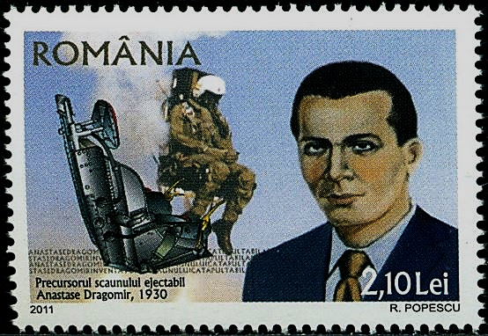
The Ejectable Seat have appeared on postage stamps

Slide 7
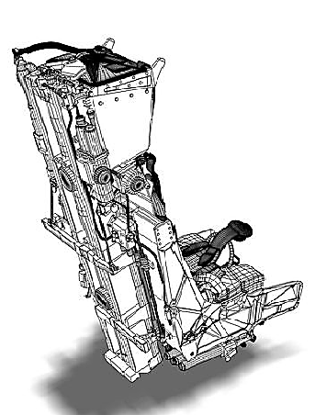
Improve the Ejectable Seat
Anastase Dragomir, however, was not only satisfied with obtaining the patent for the first version of the catapult able cab, so in the coming years he worked to improve it .
He therefore introduced a number of factors, such as air scrambling at over 4,000 meters, drastic drop in temperature in such a situation, or 3-ton-high-powered air flow that strikes the pilot catapulting out of a high-plane flying at 1,000 kilometers per hour.

Slide 8
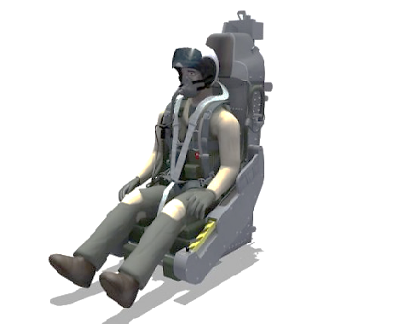
In this sense, Dragomir obtained a new invention patent in 1950 with the name of a ‘’parachute cell; but this time we are speaking of a English one, which in the description mentioned:
‘’the use of a sliding curved back for the ejection of the cabins either on the floor or on top;
the use of a watertight or semi-rigid cabin, depending on the flight at certain heights
and the use of a semi-rigid cabinets for a mechanical device that allows the oxygen and air required for life to be dispensed if necessary.’’

Slide 9
Ten years later, Dragomir put his ideas into practice in the case of passengers planes, with a system that provided catapult cabins for each passenger.
Anastase Dragomir ’s inventions were taken over by the US military . Due to the much more generous financial resources they have at their disposal, American engineers have managed to improve the catapulting cabin and turn it into a genuine ejection seat.
It was later implemented on military supersonic aircraft, and now the eject able seat has become a commonplace component of these aircrafts.
Anastase Dragomir ceased living in 1966 at the age of 70.

Slide 10
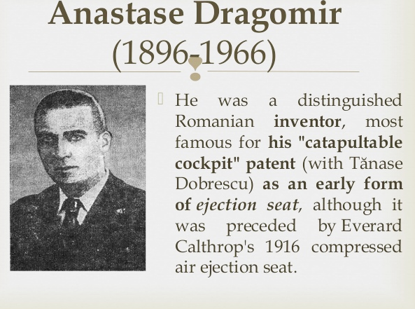
Romanians are proud of him!

Slide 11
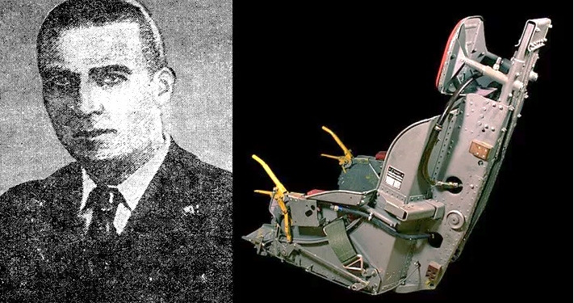
The creator and the invention

Slide 12
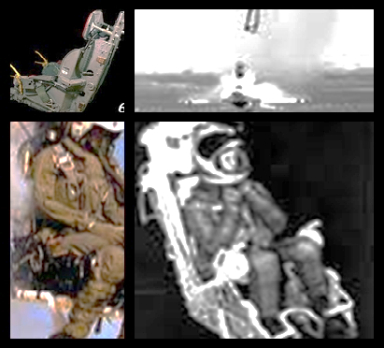
This was my presentation!

Slide 13
Thank you for watching with patient and interest!

