Slide 1
THE BASIS OF MULTIPLE TELEPHONY
MADE BY
NEAGOE DARIA-MARIA

Slide 2
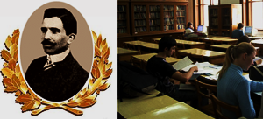
INVENTOR OF MULTIPLE PEDAGOGUE AND PHYSICIST TELEPHONY
AUGUSTIN MAIOR
1882-1963

Slide 3
The first to base and make multilingual telephony using high frequency carries.
General Manager of “Poles, Telegraphs and Telephones” from Transylvania.
Professor of Theoretical Physics, Dean of the Faculty of Sciences of the University of Cluj.
Director of the Theorectical and Applied Physics of the Academy of Sciences of Romania.

Slide 4
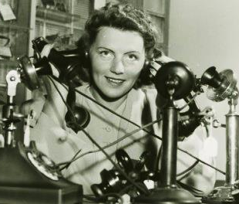
In November 1905 he is employed as an engineer at the Experimental Station in Budapest where, in 1906,he manages to conveey simultaneously,on single 15-km telephone line, five calls without interfering signals.
The theoretical multi-phone tapes were publishedd in 1907 the magazine “Elektrotechische Zeitschtift” and then in 1914 “The Electrician” magazin e, in The Hight-Frequency Alternating Currents in Telegraphy, telephony and for Power Transmission.

Slide 5
Under the title, Uber Mehirfach-Femsprechen “On Multiple Telephoney” publishes in the German magazine “Elektrotechnische Zeitschrift” results its experimental and theoretical research.
It demonstrates mathematically that multiple telephony can be obtained using high frequency alternating currents, so that each affective current can be the carrier of a microphone current.
More streams can be transmitted on the same line.
American Magazine “Electrical World” published in 1907 a summary of this article under the title “ Multiple Telephony” Maior continues his experiments on artificial iron tracks, 15-20 km long.

Slide 6
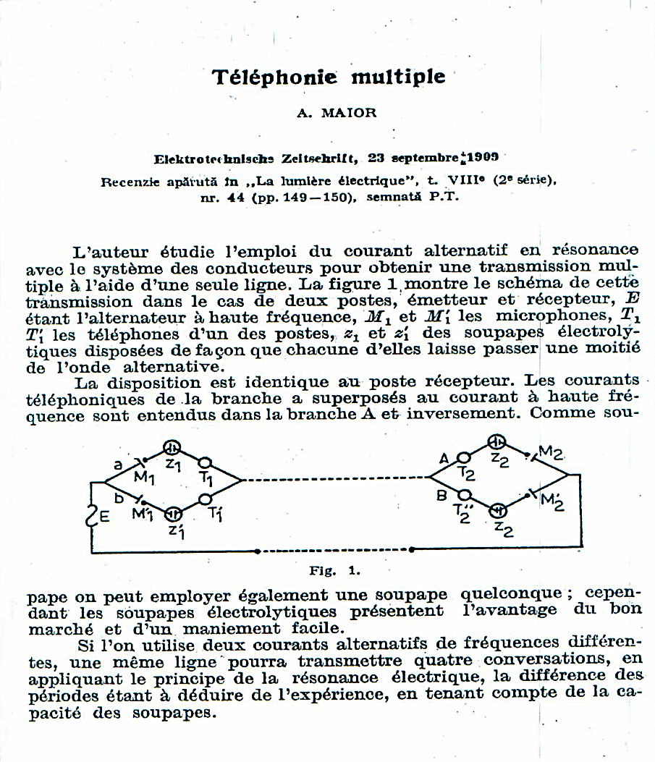
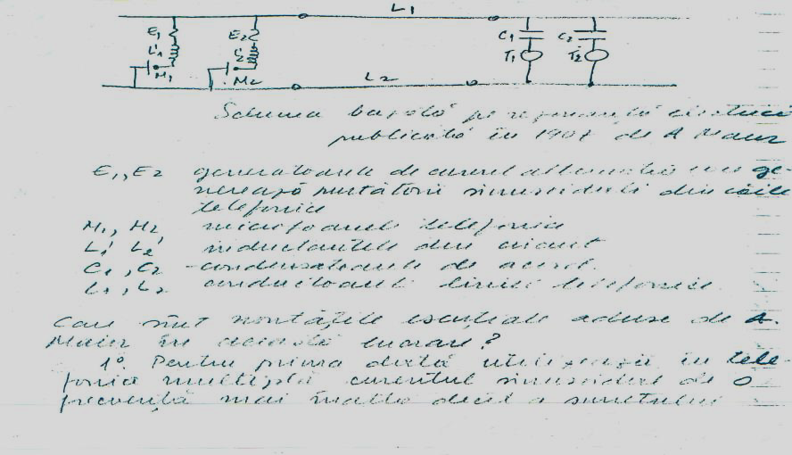

Slide 7
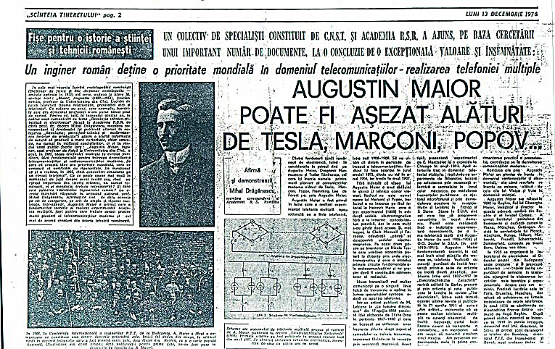
AUGUSTIN MAIOR can be seated next to TESLA, MARCONI, POPOV…

Slide 8
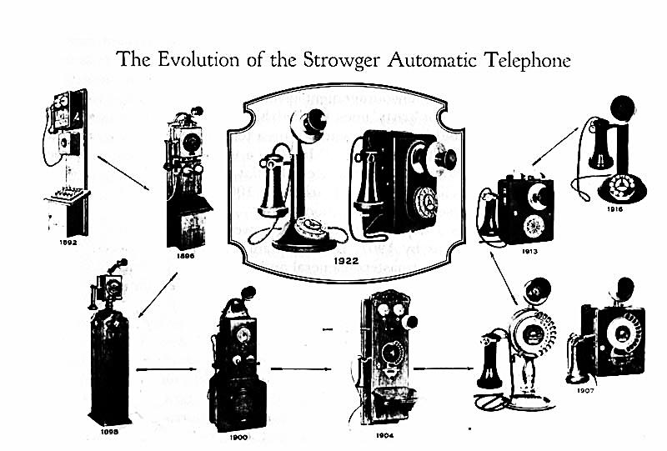

Slide 9
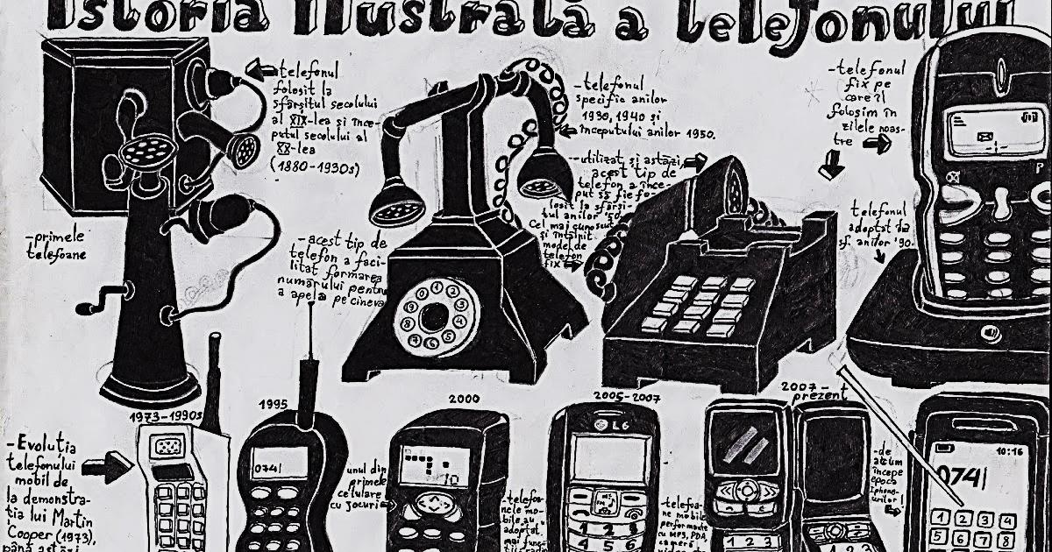
TELEPHONY YESTERDAY AND TODAY

Slide 10

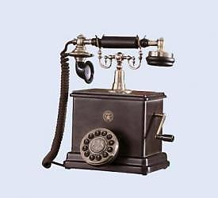
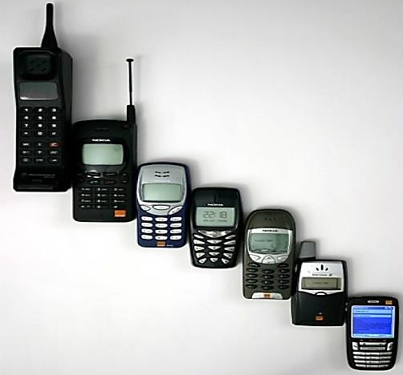
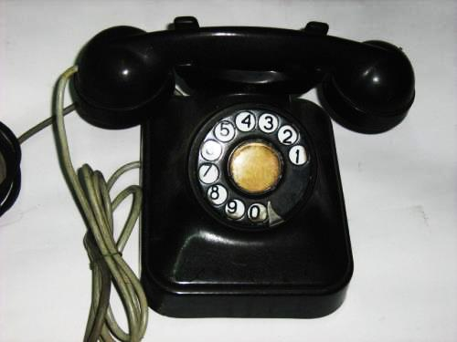

Slide 11
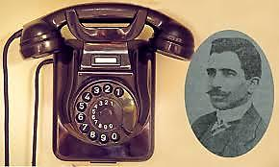
Thought the work of one’s life, Augustine Maior, demonstrates that the work of a scientist, modest or valuable, stimulates the original creation of the generates in the generation, has the role and duty to contribute.
As the information of the scientific tradition of a people-that factor indispensable to the creative activity the generations that will win.

Slide 12
THANK
YOU!

